Slide 1

Bus Booking System using(AWS) by
Nikhil Bamane BE-4 13
Mohammad Bhanpurwala BE-4 14
Under the Guidance of
Ms. Deepti Nikumbh (Guide)
DEPARTMENT OF COMPUTER ENGINEERING
SHAH AND ANCHOR KUTCHHI ENGINEERING COLLEGE
CHEMBUR, MUMBAI-400088.
2019-2020

Slide 2
CONTENT
Chapter 1. Introduction.
Chapter 2. Problem Statement.
Chapter 3. Project Design.
Chapter 4. Summary.
Chapter 5. References.

Slide 3
INTRODUCTION
Public transport especially buses are getting crowded day-by-day due to heavy demand of transport facility.
This kind of chaos is mainly due to irregular Planning of bus intervals and not knowing the details of the amount of passengers expected at a time.
Cloud is the best platform to implement this system as the storage is dynamic in cloud and interface can be easily provided to people

Slide 4
PROBLEM STATEMENT
Some of the existing system uses manual process which increase a lot of paper work and it’s time consuming.
However this have limitation such as paper costing.
Poor manual systems of time and record management can lead to many problems.
Paper and time consuming.
No data is preserved.

Slide 5
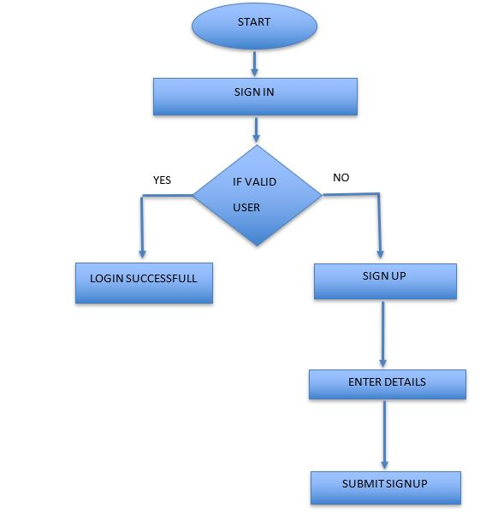
PROJECT DESIGN

Slide 6
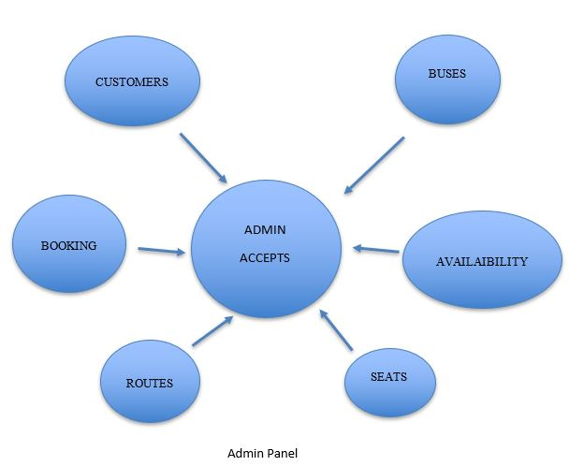
PROJECT DESIGN

Slide 7
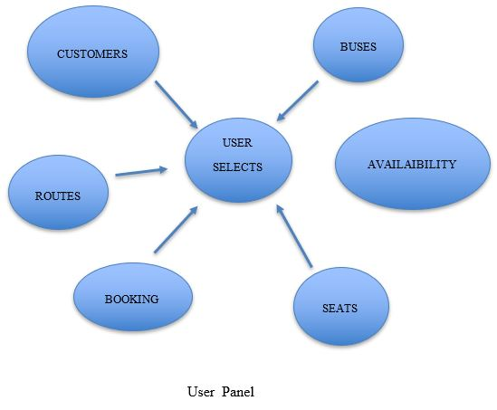
PROJECT DESIGN

Slide 8
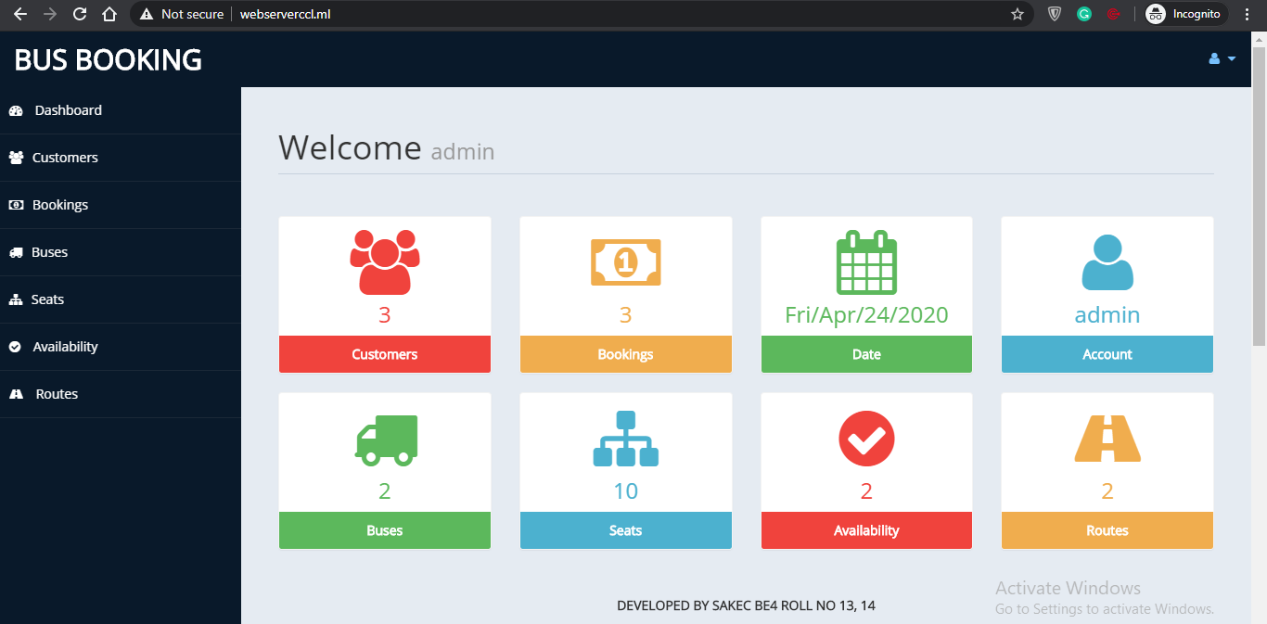

Slide 9
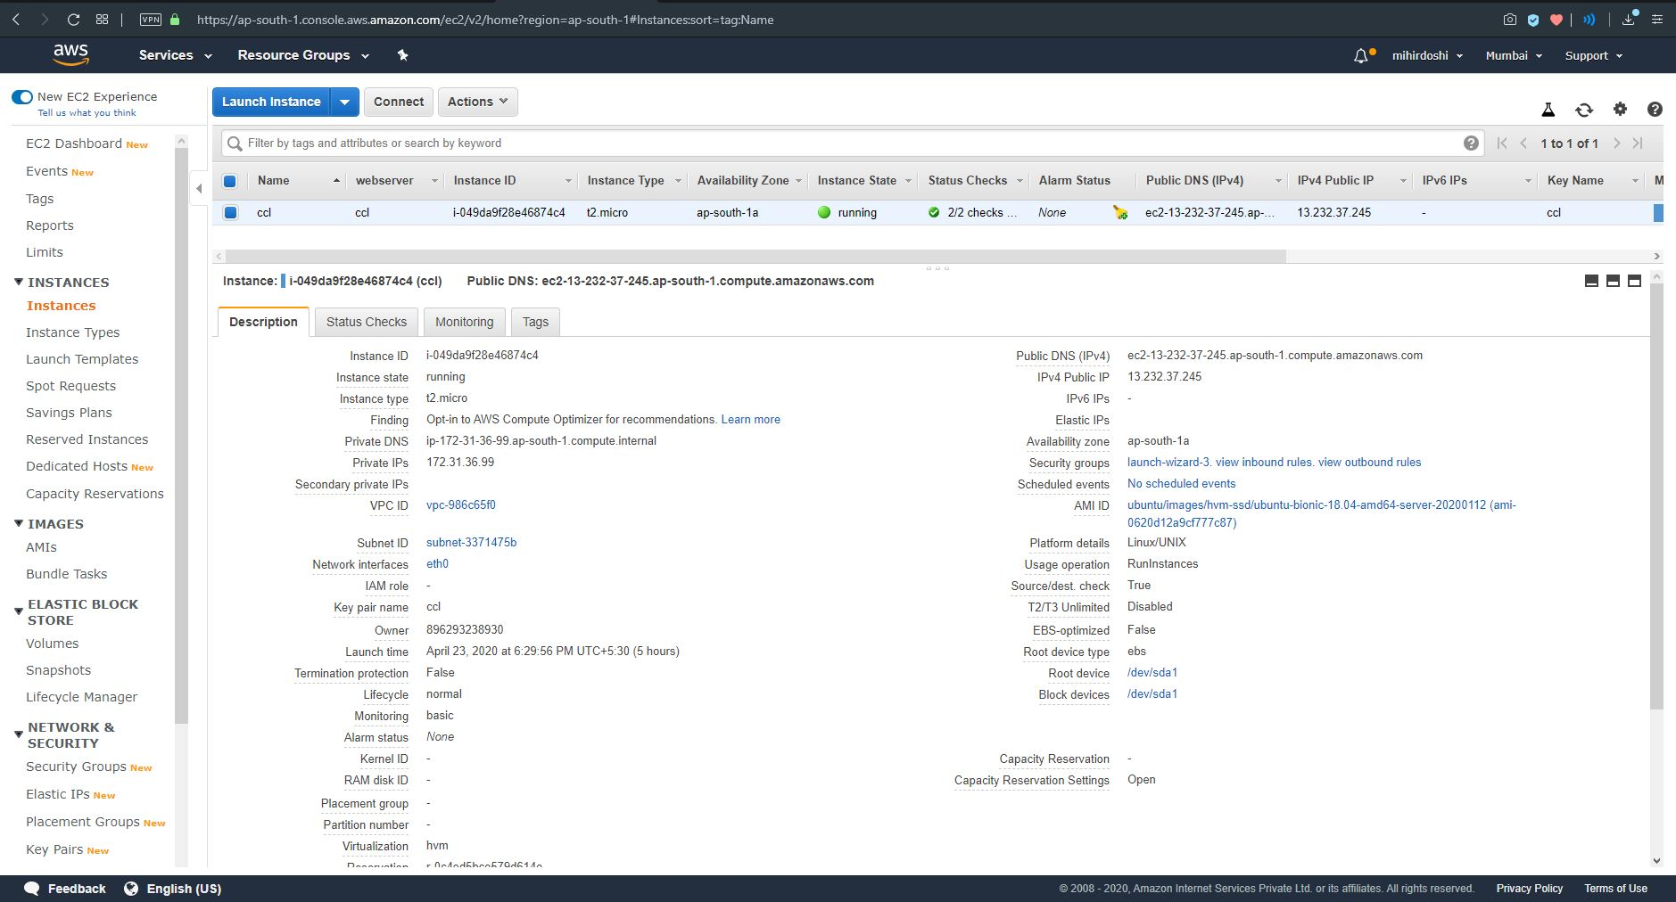
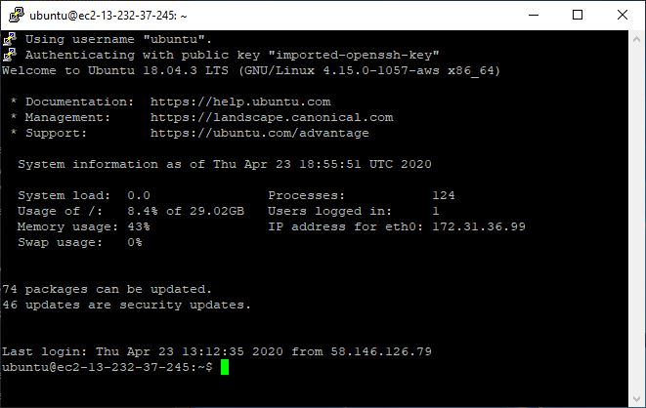
Putty
AWS Instance

Slide 10
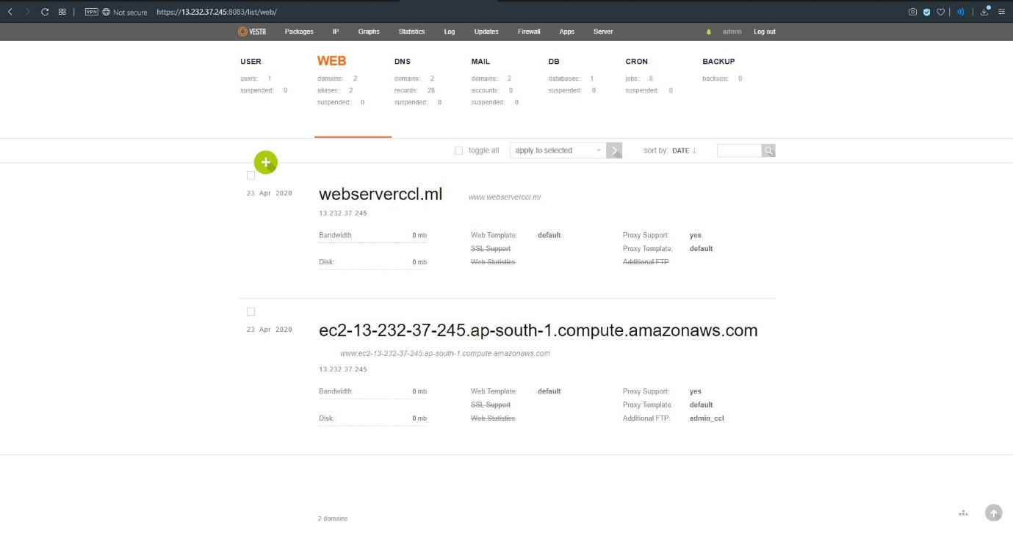
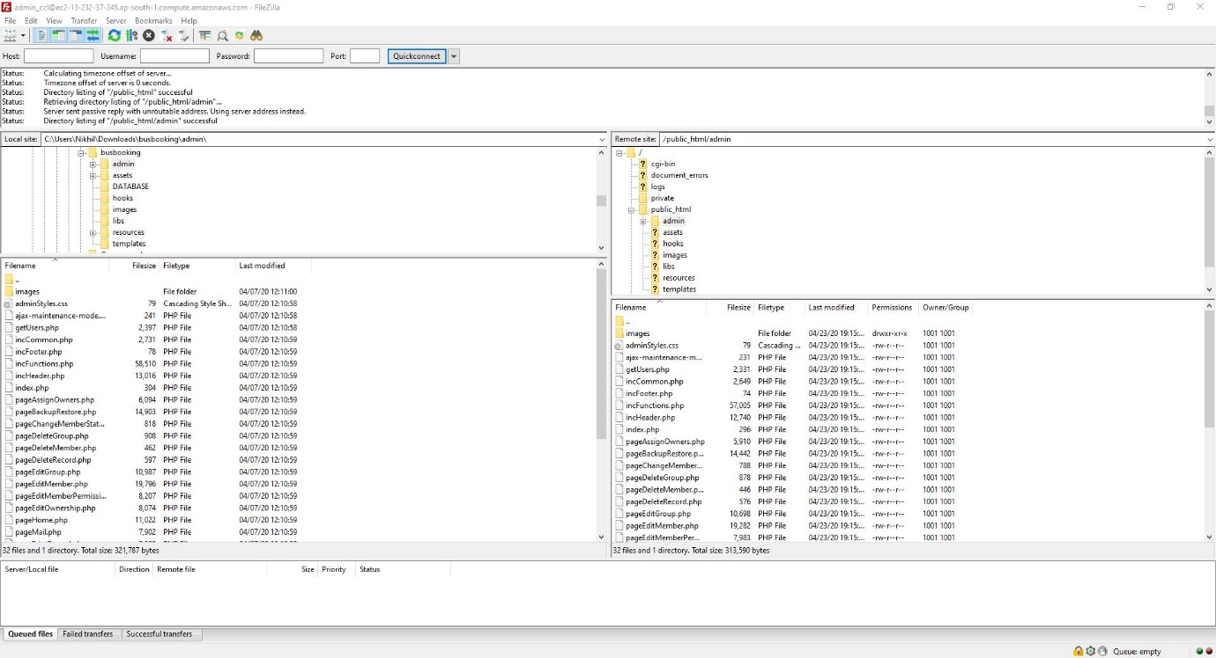
FileZilla
Vesta Control Panel

Slide 11
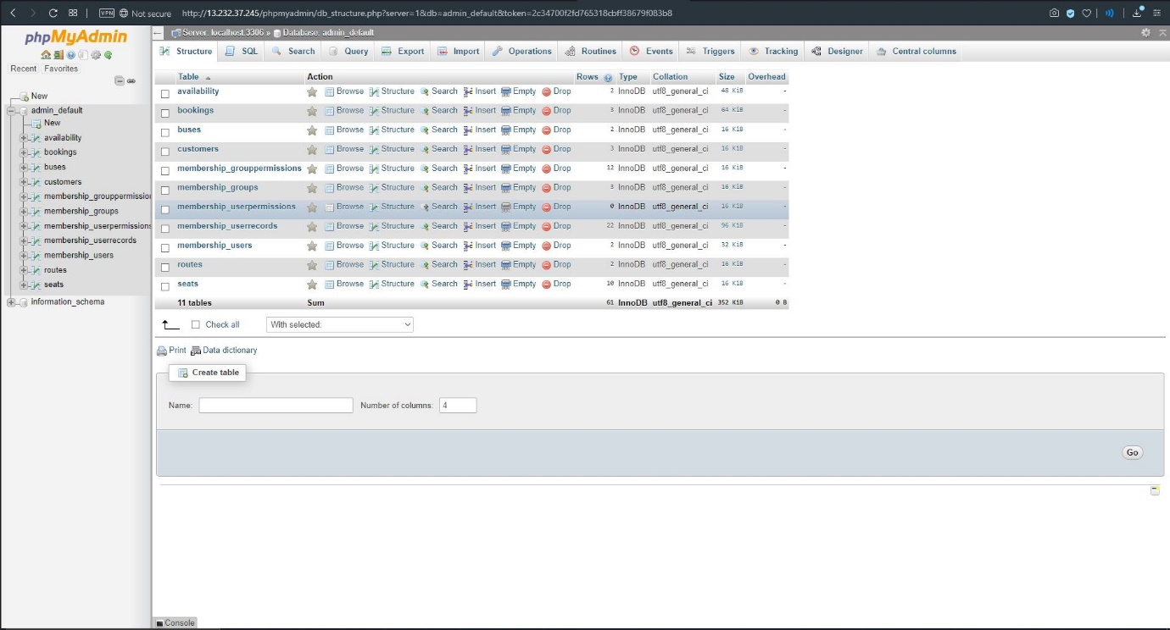
PhpMyAdmin

Slide 12
SUMMARY
Nowadays, bus agencies are taking important role in transportation, and to make reservation reliable they need a strong system that they will make reservation easier, faster and safer.
This project designed to meet requirements of a bus reservation system. It has been developed in XHTML, PHP, CSS, JAVASCRIPT and database has been built in MySQL.
By using this application, the company can provide reservation services and information to their customers without the limitation of office hours or manpower.
Not only does it let customers book trips around the clock from any location with an internet connection but it is also designed for use by the company to internally manage their business processes; minimizing human errors and overcoming difficulties and problems that arose in the previous system.

Slide 13
REFERENCES
[1] M. A. HANNAN, A. M. MUSTAPHA, A. HUSSAIN and H. BASRI.Intelligent Bus Monitoring and Management System. Proceedings of the World Congress on Engineering and Computer Science 2012 Vol II WCECS 2012, October 24-26, 2012, San Francisco, USA
[2] Oloyede, M.O. 1 *, Alaya S.M. 2 Adewole, K.S 3. Development of an Online Bus Ticket Reservation System for a Transportation Service in Nigeria. Computer Engineering and Intelligent Systems ISSN 2222-1719 (Paper) ISSN 2222-2863 (Online) Vol.5, No.12, 2014.
[3] Sharmin Akter, Thouhedul Islam, Rashidah F. Olanrewaju, Ajayi Adeniyi Binyamin. A Cloud-Based Bus Tracking System Based on Internet-of-Things Technology. 2019 7th International Conference on Mechatronics Engineering (ICOM).
[4] Vinayak Nair, Amit Pawar, D. L. Tidke, Vishakha Pagar and Nikita Wani. Online Bus Tracking and Ticketing System. MVP Journal of Engineering Sciences, Vol 1(1), DOI: 10.18311/mvpjes/2018/v1i1/18297, June 2018.
[5] Filipe Araujo, Marilia Curado, Pedro Furtado, Raul Barbosa. Taking an Electronic Ticketing System to the Cloud: Design and Discussion. 2014 IEEE International Conference on Big Data.
[6] Nwakanma Ifeanyi Cosmas, Etus C, Ajere I.U. & Agomuo Uchechukwu Godswill. Online Bus Ticket Reservation System. IIARD International Journal Of Computer Science And Statistics Vol. 1 No.2, 2015 www.iiardonline.org

